Slide 1



e-con Systems Inc – Training 2013

Slide 2

Session Brief
Memory Layout
Stack vs Heap. What is stored where?
Usage of stacks in functions
Memory related functions in C
Memory allocation process
Allocation Algorithm
Memory Corruption – Overflow – Underflow - Handling

Slide 3
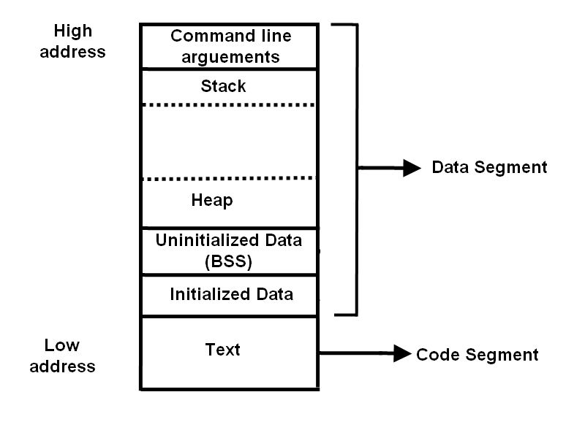
Memory Layout in C

Slide 4
Memory Layout in C
Code Segment – Contains programs execution instruction. Read-only region.
Data Segment – Holds data being processed by the code. Read-Write region.
Stack – Starts from higher Virtual address and extends to lower VA.
Heap – Starts from lower VA (after UI Data) to higher VA.

Slide 5
Stack vs Heap
Factors | Stack | Heap
Scope | Function | Application
Size, allocation | Fixed – Max by Compiler - Automatic | Dynamic – on demand – by user
Speed | Faster - LIFO | Slower due to complex access
Storage | Local, return address and function arguments | Data used by Program
Errors | Overflow, underflow | Null pointer, large block request, memory leak

Slide 6
What is Stored where?
Variable/Qualifier Type | Location
Local | Stack
Global | Stored at Uninitialized Data segment (Block Start Symbol).
Static | Stored at Initialized Data segment
Auto | Stack
Register | Will be located in CPU register, else on worst case located at Stack
Extern | Data segment. Only one instance of this type variable is created to avoid name collision
Const | Stored in read-only text segment

Slide 7
Sample code
int Stack_Heap()
{
char *pBuffer; //<--nothing allocated yet (excluding the pointer itself, which is allocated here on the stack).
bool b = true; // Allocated on the stack.
if(b) {
//Create 500 bytes on the stack
char buffer[500];
//Create 500 bytes on the heap
pBuffer = new char[500];
}//<-- buffer is deallocated here, pBuffer is not
}//<--- what is missing here?

Slide 8
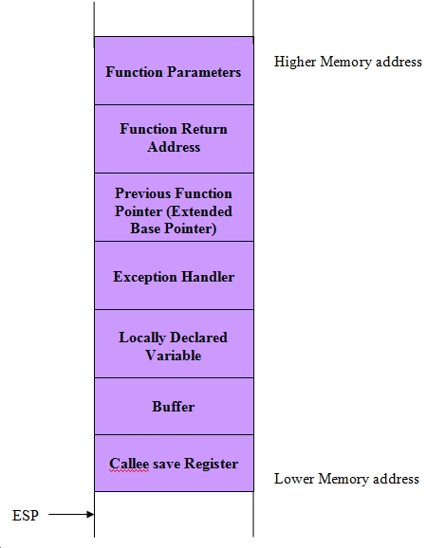
Role of Stack in Functions
Functions arguments – Right to left
Function return address (EIP)
Extended Base Pointer
Try/catch or other structural exception handling.
Local variables.
Local buffers being used in function.
ESI, EDI and EBX
ESI – Extended Source Index
EDI – Extended Destination Index
EBX – Extended Base Register

Slide 9
Memory related Functions in C
Allocate memory for requested number of bytes.
  void* malloc (size_t size);
Extend the number of bytes allocated.
  void* realloc (void* ptr, size_t size);
Same as malloc, but initializes the memory with zero.
  void* calloc (size_t num, size_t size);
Set the value of the memory specified by pointer to specified value.
  void * memset ( void * ptr, int value, size_t num );
Returns the size of memory block allocated in heap
  size_t _msize( void *memblock );
Deallocate the memory
  void free (void* ptr);

Slide 10
Memory related Functions in C
Compares character in two memory
  int memcmp( const void *buf1, const void *buf2, size_t count );
  < 0 – buf1 less than buf2
  > 0 – buf2 less than buf1
  = 0 – both buffer are identical
Copies content from source to destination
  void *memcpy( void *dest, const void *src, size_t count );
  On success, returns number of bytes copied.
Finds the character in the buffer. On success, returns the pointer to the found character.
  void *memchr( void *buf, int c, size_t count );
Moves one buffer to other.
  void *memmove( void *dest, const void *src, size_t count );

Slide 11
Sample Code for Memory Functions
int main()
{
char *ptr = NULL;
ptr = (char*)malloc(1000);//Here we are allocating 1000 bytes of memory accessed through char*.
if(ptr != NULL)
{
printf("Memory Base address: 0X%X\n", ptr);
//Lets increase the memory allocated.
ptr = (char*)realloc(ptr, 2000);
if(ptr != NULL)
{
//Reset the content of memory
memset(ptr, '1', _msize(ptr));
printf("Expanded Memory Base address: 0X%X\n", ptr);
}
//ptr = (char*)calloc(200, sizeof(char));
free(ptr);
}
return 0;
}

Slide 12
Sample Code for Memory accessories Functions
char msg[50] = "abcdefghijklmnopqrstuvwxyz";
char temp[50];
void main()
{
strcpy(temp, msg);
printf("Original Msg = %s\n",temp);
memcpy(temp+4, temp+16, 10);
printf("After memcpy without overlap = %s\n",temp);
strcpy(temp , msg);
memcpy(temp+6, temp+4, 10);
printf("After memcpy with overlap = %s\n",temp);
strcpy(temp, msg);
printf("Original Msg = %s\n",temp);
memmove(temp+4, temp+16, 10);
printf("After memmove without overlap = %s\n",temp);
strcpy(temp , msg);
memmove(temp+6, temp+4, 10);
printf("After memmove with overlap = %s\n",temp);
}

Slide 13
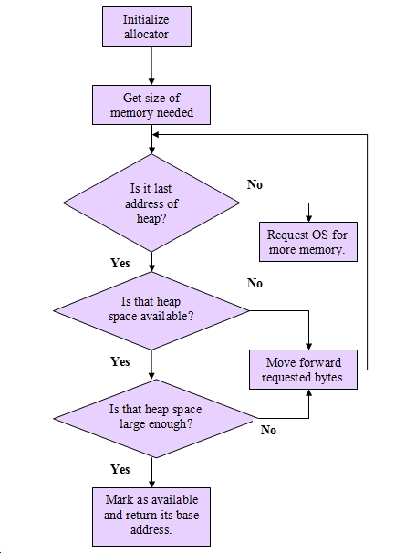
Memory allocation process

Slide 14

Memory Allocation Technique
First Fit
  Based on memory location
  Increasing size
  Decreasing size
Buddy System
Suballocator

Slide 15

Memory related issues
Null Pointer reference
Memory Overflow
Pointer dereference
Memory Leak
Memory Alignment

Slide 16
Use Case for Memory Handling
int main()
{
int *ptr1, *ptr2, *ptr3;
printf("Pointer : %x\n", *ptr1);
ptr1 = (int*)malloc(sizeof(int) * 1000);
ptr3 = (int*)malloc(sizeof(int) * 2000);
printf("Pointer : %x\n", *(ptr1 + 6000));
ptr2 = ptr1;
free(ptr1);
free(ptr2);
return 0;
}

Slide 17
Use Case for memory leak
void main()
{
char *input = NULL;
unsigned int i = 0, ret = 0;
for(i = 0; i < 10; i++)
{
input = (char*)calloc(100, sizeof(char));
gets(input);
ret = strcmp(input, "abcd");
if(ret == 0)
puts(input);
else
printf("Some other stuffs!!!\n");
}
}

Slide 18
Memory Alignment
typedef struct structa { char c; short int s; } structa_t; Structure Size: | typedef struct structb { short int s; char c; int i; } structb_t; Structure Size:
typedef struct structc { char c; double d; int s; } structc_t; Structure Size: | typedef struct structd { double d; int s; char c; } structd_t; Structure Size:

Slide 19
Tips to overcome memory related issues
Always perform validation for newly allocated pointers.
Always declare structure member in their increasing/decreasing order of size to avoid misalignment.
Use memset/calloc for memory pointer.
Be cautious while derefering pointer.
Before freeing any memory, make sure it is not NULL.
Use the Visual Studio debugger tools to analyze your allocated memory.
Make sure the size of memory actually needed before allocation.
Always free the dynamically allocated memory to avoid memory leak.

Slide 20

Memory in C – By Sathya Kumar P

